Slide 1
Blockchain Security Issues and Challenges
BY:NIDHI
USN:1NT17IS110

Slide 2
Security Issues and Challenges
The Majority Attack (51% Attacks)
Fork Problems
Scale of Blockchain
Time Conﬁrmation of Blockchain Data
Current Regulations Problems
Integrated Cost Problem

Slide 3
The Majority Attack (51% Attacks)
If someone has more than 51% computing power, then he/she can ﬁnd Nonce value quicker than others, means he/she has authority to decide which block is permissible.
What it can do is:
Modify the transaction data, it may cause double spending attack
To stop the block verifying transaction
To stop miner mining any available block.

Slide 4
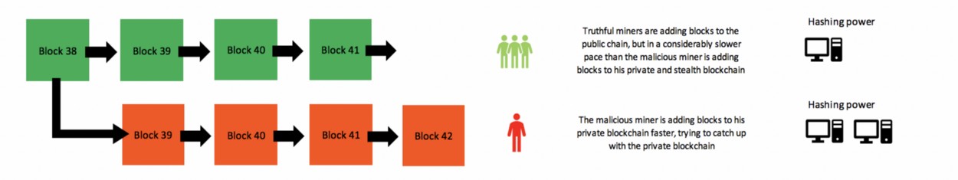
Truthful miners are adding blocks to the public chain,but in considerably slower pace than the malicious miner is adding blocks to his private blockchain.
The malicious miner is adding blocks to his private blockchain faster.

Slide 5
Fork Problems
Another issue is fork problem.
Fork problem is related to decentralized node version, agreement when the software upgrade. It is a very important issue because it involving a wide range in blockchain.
When the new version of blockchain software published, new agreement in consensus rule also changed to the nodes. Therefore, the nodes in blockchain network can be divided into two types, the New Nodes and the Old Nodes. So here come four situations:
The new nodes agree with the transaction of block which is sended by the old nodes.
The new nodes don’t agree with the transaction of block which is sended by the old nodes.
The old nodes agree with the transaction of block which is sended by the new nodes.
The old nodes don’t agree with the transaction of block which is sended by the new nodes.

Slide 6
Because of these four different cases in getting consensus, fork problem happens, and according to these four cases, fork problems can be divided into two types, the Hard Fork and the Soft Fork.
Hard Fork
Hard Fork means when system comes to a new version or new agreement, and it didn’t compatible with previous version, the old nodes couldn’t agree with the mining of new nodes, so one chain became two chains.
When Hard Fork happens, we have to request all nodes in the network to upgrade the agreement, the nodes which haven’t been upgrade will not continue to work as usual.
If there were more old nodes didn’t upgrade, then they will continue to work on the other completely diﬀerent chain, which means the ordinary chain will fork into two chains

Slide 7
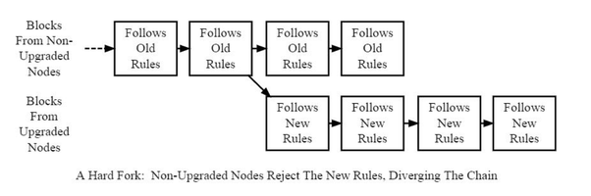

Slide 8
1)Backward Incompatible
2)Chain Splits into 2 chains
Example:
Bitcoin Hardfork in 2018
New Coin : Bitcoin Cash
New Feature : Block size increased from 1MB To 8MB
Purpose:To allow for more transactions to be processed
There by reducing fees that users pay and minimizing
the bottleneck of Bitcoins network as usage increased.

Slide 9
Soft Fork
Soft Fork means when system comes to a new version or new agreement, and it didn’t compatible with previous version, the new nodes couldn’t agree with the mining of old nodes.
Because the computing power of new nodes are stronger than old nodes, the block which is mining by the old nodes will never be approve by the new nodes, but new nodes and old nodes will still continue to work on the same chain.
When Soft Fork happens, nodes in the network don’t have to upgrade the new agreement at the same time, it allows to upgrade gradually

Slide 10
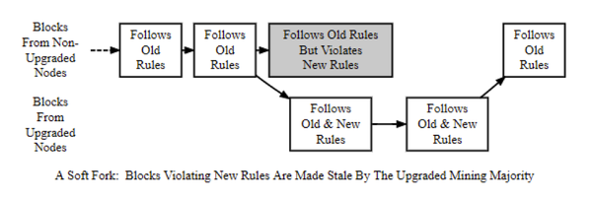

Slide 11
Not like Hard Fork, Soft Fork will only have one chain.
However, Soft Fork makes the old nodes unaware that the consensus rule is changed, contrary to the principle of every nodes can verify correctly to some extent.

Slide 12
1)Backward compatible
2)No blockchain splits
Soft Fork examples:
1)Bitcoin Improvement Proposal 66(BIP-66)
A soft fork on Bitcoins signature validation
2)Pays To Script Hash(P2HS)
A soft fork that enabled multi-signature addresses
in Bitcoins network.

Slide 13
Scale of Blockchain
As blockchain growing, data becomes bigger and bigger, the loading of store and computing will also get harder and harder, it takes plenty of time to synchronize data, in the same time, data still continuely increase, brings a big problem to client when running the system.
Simpliﬁed Payment Veriﬁcation (SPV) is a payment veriﬁcation technology, without maintain full blockchain information, only have to use block header message. This technology can greatly reduce user’s storage in blockchain payment veriﬁcation, lower the user’s pressure when transaction drastically increased in the future.

Slide 14
Time Confirmation of Blockchain Data
Compared to traditional online credit card transaction, usually takes 2 or 3 days to conﬁrm the transaction, bitcoin transaction only have to use about 1 hour to verify, it’s much better than the usual, but it’s still not good enough to what we want it to.
Lightning Network is a solution to solve this problem
Lightning Network is a proposed implementation of Hashed Timelock Contracts (HTLCs) with bi-directional payment channels which allows payments to be securely routed across multiple peer-to-peer payment channels. This allows the formation of a network where any peer on the network can pay any other peer even if they don’t directly have a channel open between each other.

Slide 15
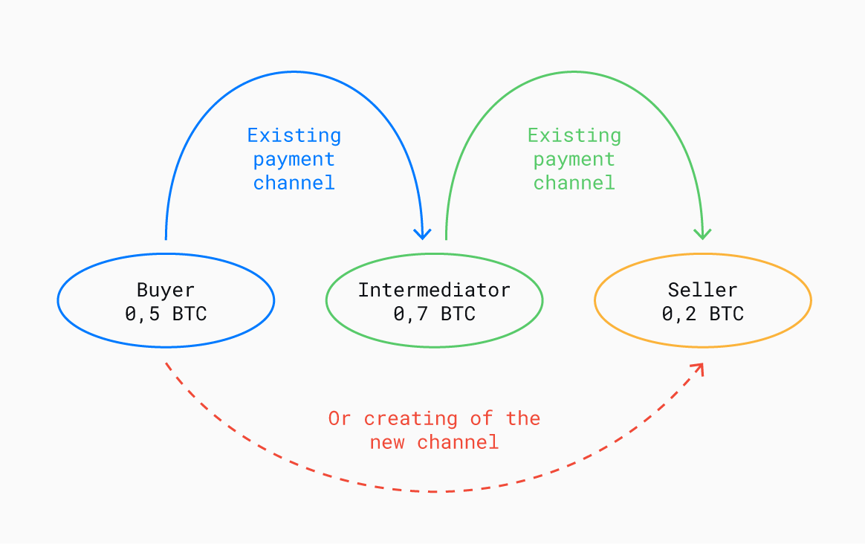

Slide 16
Current Regulations Problems
Use Bitcoin for example, the characteristics of decentralized system, will weak the central bank’s ability to control the economic policy and the amount of money, that makes government be cautious of blockchain technologies, authorities have to research this new issue, accelerate formulating new policy, otherwise it will have risk on the market.

Slide 17
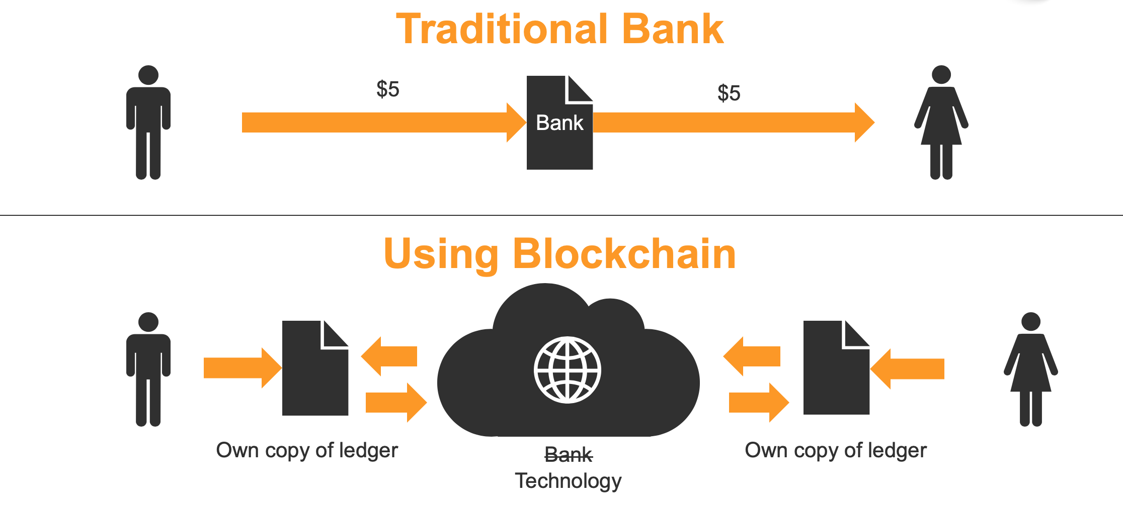

Slide 18
Integrated Cost Problem
It will have lot of cost including time and money to change existing system, especially when it’s an infrastructure.
We have to make sure this innovative technology not only create economic beneﬁts, meet the requirements of supervision, but also bridge with traditional organization, and it always encounter diﬃculties from internal organization which is existing now.

Slide 19
CONCLUSION
There’s no doubt that blockchain is a hot issue in recent years, although it has some topics we need to notice, some problems has already been improved along with new technique’s developing on application side, getting more and more mature and stable.
The government have to make corresponding laws for this technology, and enterprise should ready for embrace blockchain technologies, preventing it brings too much impact to current system.
When we enjoy in the advantage of blockchain technologies bring to us, in the same time, we still have to stay cautious on its inﬂuence and security issues that it could be have.

